Slide 1
TaskPilot
By: Russell Addo

Slide 2
Objective
The primary objective of this application is to allow users to efficiently manage their daily tasks while enabling them to monitor progress in a structured and user-friendly way. Designed specifically for individuals who seek a organized method to handle their responsibilities, the application facilitates listing, categorizing, and tracking the completion of tasks. It is tailored to offer a balance of simplicity and functionality, addressing the challenges users often face when trying to stay on top of their tasks.
Many existing task management applications fall short of meeting user needs, either because they are overly complicated or lack essential features such as progress tracking. This tool fills that gap by offering a straightforward, intuitive system that combines task management with clear progress indicators. By doing so, it not only helps users remain organized but also provides them with the motivation to complete their tasks and achieve their goals. Whether managing work-related projects or personal to-do lists, this application delivers a practical solution for individuals aiming to boost their productivity and maintain better control over their daily activities.

Slide 3

Demonstration of App

Slide 4
Core Features
Task Management: The application allows users to seamlessly create, update, and delete tasks, ensuring they have complete control over their to-do lists. This feature provides the flexibility needed to adapt to changing priorities and keep task lists relevant and organized.
Progress Tracking: Users can easily visualize their progress on tasks, providing them with a clear sense of accomplishment. This feature helps maintain motivation by offering real-time feedback on completed tasks and progress made towards goals.
Calendar View: Tasks are displayed on a calendar interface, enabling users to plan their time effectively. By organizing tasks by date.

Slide 5


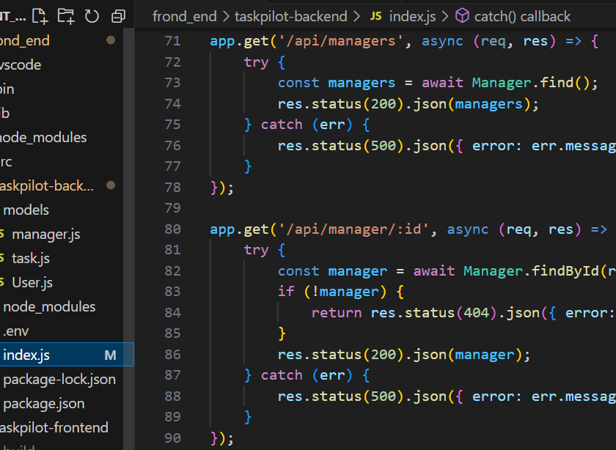

Backend
The backend code connects to a MongoDB database using Mongoose to store and retrieve data for users, tasks, and managers. The mongoose.connect() function ensures a stable database connection, allowing the app to perform CRUD operations. This is necessary for persistent data storage and managing tasks and users.
User authentication is handled using bcrypt for password hashing and JWT for secure login. The POST api route hashes passwords for secure storage, and the POST api validates user credentials and issues a JWT token for authenticated requests. This protects user data and ensures only authorized users can access their information.
The Manager model allows for creating, reading, updating, and deleting manager records. Routes like POST api manager create managers, while GET /api/managers and GET /api/manager/:id retrieve manager details. This functionality is crucial for managing roles within the application.
The Task model manages tasks with CRUD operations. The POST /api/tasks route creates tasks, GET /api/tasks/:userId retrieves tasks for a user, and PUT /api/tasks/:id updates task details. The DELETE /api/tasks/:id route deletes tasks, enabling efficient task management for users.
The app.listen() function sets the backend server to listen on port 8000. This allows the app to handle incoming requests, ensuring real-time interaction between the client and server for task and user management.
This setup is essential for maintaining security, data integrity, and efficient task management in the application.

Slide 6
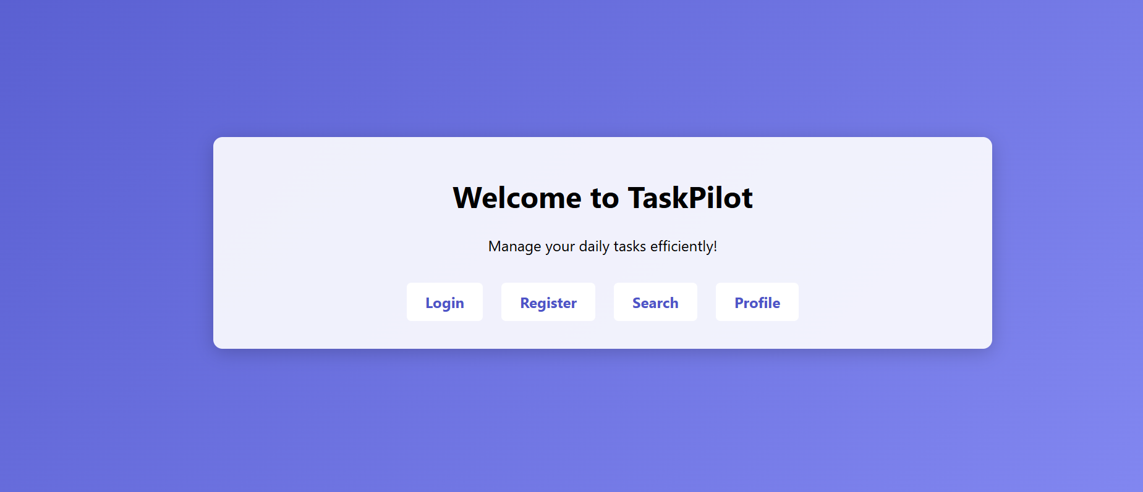
Frontend
The Register component provides a registration form where users can create an account by entering their email and password. The password is hashed using bcrypt on the backend through the POST /api/register route, ensuring secure password storage. Upon successful registration, a confirmation message is displayed, assuring users that their account has been created.
The MainRoutes component defines the routing structure of the application using react router dom, including routes for navigating between pages like Home, Login, Register, Search, Profile, and Calendar. This routing component ensures users can smoothly navigate between different sections of the app. The Profile component displays a user’s profile information by fetching user details from the backend using the GET api endpoint. Once the data is retrieved, it is displayed on the page, allowing users to view their personal details and enhancing engagement with the app.
The Login component enables users to log into their accounts by submitting their email and password. After a successful POST request to the backend’s login endpoint, a JWT token is returned and stored in localStorage for subsequent requests. Upon successful login, users are redirected to the Calendar page, ensuring secure authentication before accessing their tasks. Lastly, the Home component acts as the landing page of the app, introducing users to TaskPilot and providing navigation links to key pages such as Login, Register, Search, and Profile. This page serves as the gateway to the app, guiding users toward its primary features and functionalities. These frontend components work together to create a seamless and secure user experience, while the backend handles authentication and task management.

Slide 7
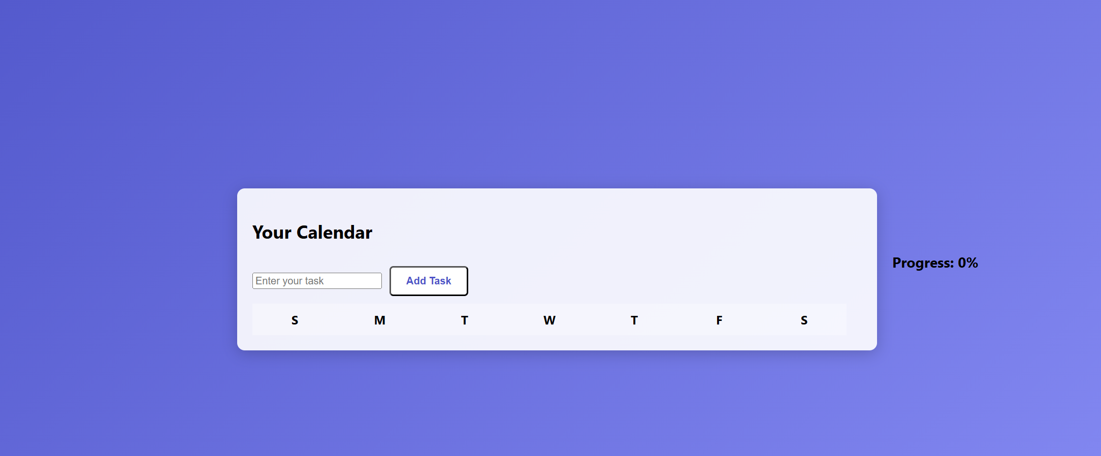
Calendar
The Calendar component allows users to manage their tasks for the week in a visually organized way. It uses the useState hook to track the state of tasks, the current task input, the selected day for adding tasks, and progress on task completion. Initially, the tasks are represented as an array of 7 days, each containing an array of tasks. The useEffect hook calculates the user's task completion progress, updating the progress bar as tasks are marked as completed.
The handleAddTask function allows users to add a new task for the selected day or edit an existing one. When a task is added or updated, the tasks array is updated accordingly. If a task is to be edited, the task’s text is displayed in the input field, and the specific task can be updated. Users can also delete tasks using the handleDeleteTask function, which removes the selected task from the appropriate day.
To track task completion, the handleToggleComplete function allows users to toggle a checkbox for each task. If a task is completed, it is visually marked with a strikethrough. The calendar view is made interactive, displaying the days of the week as clickable elements. Clicking a day selects it, allowing users to add tasks for that specific day.
The component also includes a user profile section with a settings icon and profile picture, adding a personal touch to the page. At the bottom, a progress section visually displays the user's task completion progress with a progress bar, giving users an immediate sense of how many tasks they’ve completed. The calendar interface encourages efficient task management while providing a clear visual representation of the user's productivity.

Slide 8
TaskPilot
That concludes the in depth look of my application

